Slide 1
Conversion Of Electromechanical Energy
Using Object Oriented Programming

Slide 2
Presentation Team
Kalyan - CB.EN.U4ELC22004
Javali - CB.EN.U4ELC22007
Sai Pavan – CB.EN.U4ELC22011
Kiran - CB.EN.U4ELC22065
Anil – CB.EN.U4ELC22066

Slide 3
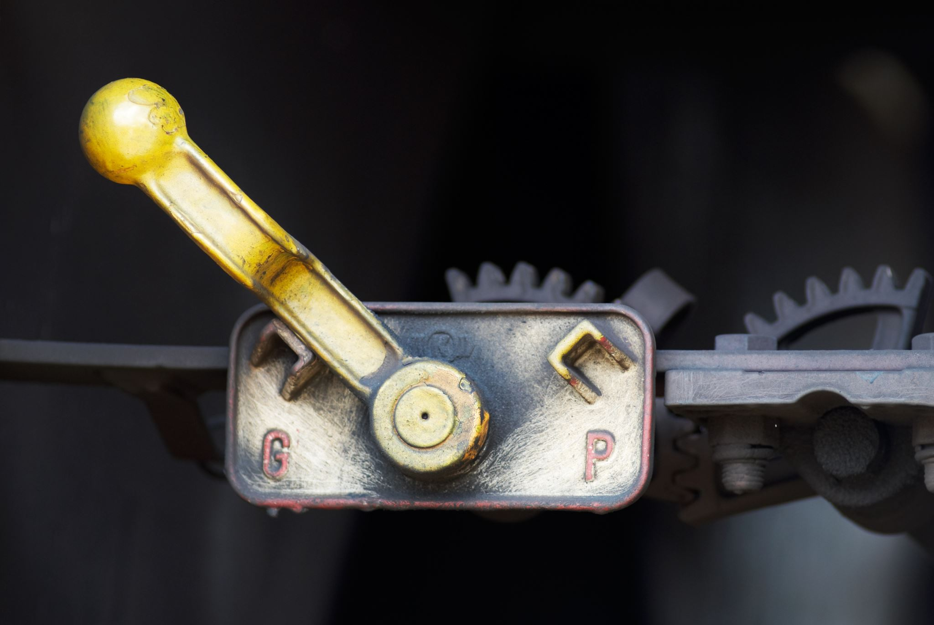
Applications of DC Generator
Charging batteries
Providing lighting
Providing excitation to alternators
Providing field excitation current for regenerative braking in DC locomotives
Laboratory and commercial testing

Slide 4
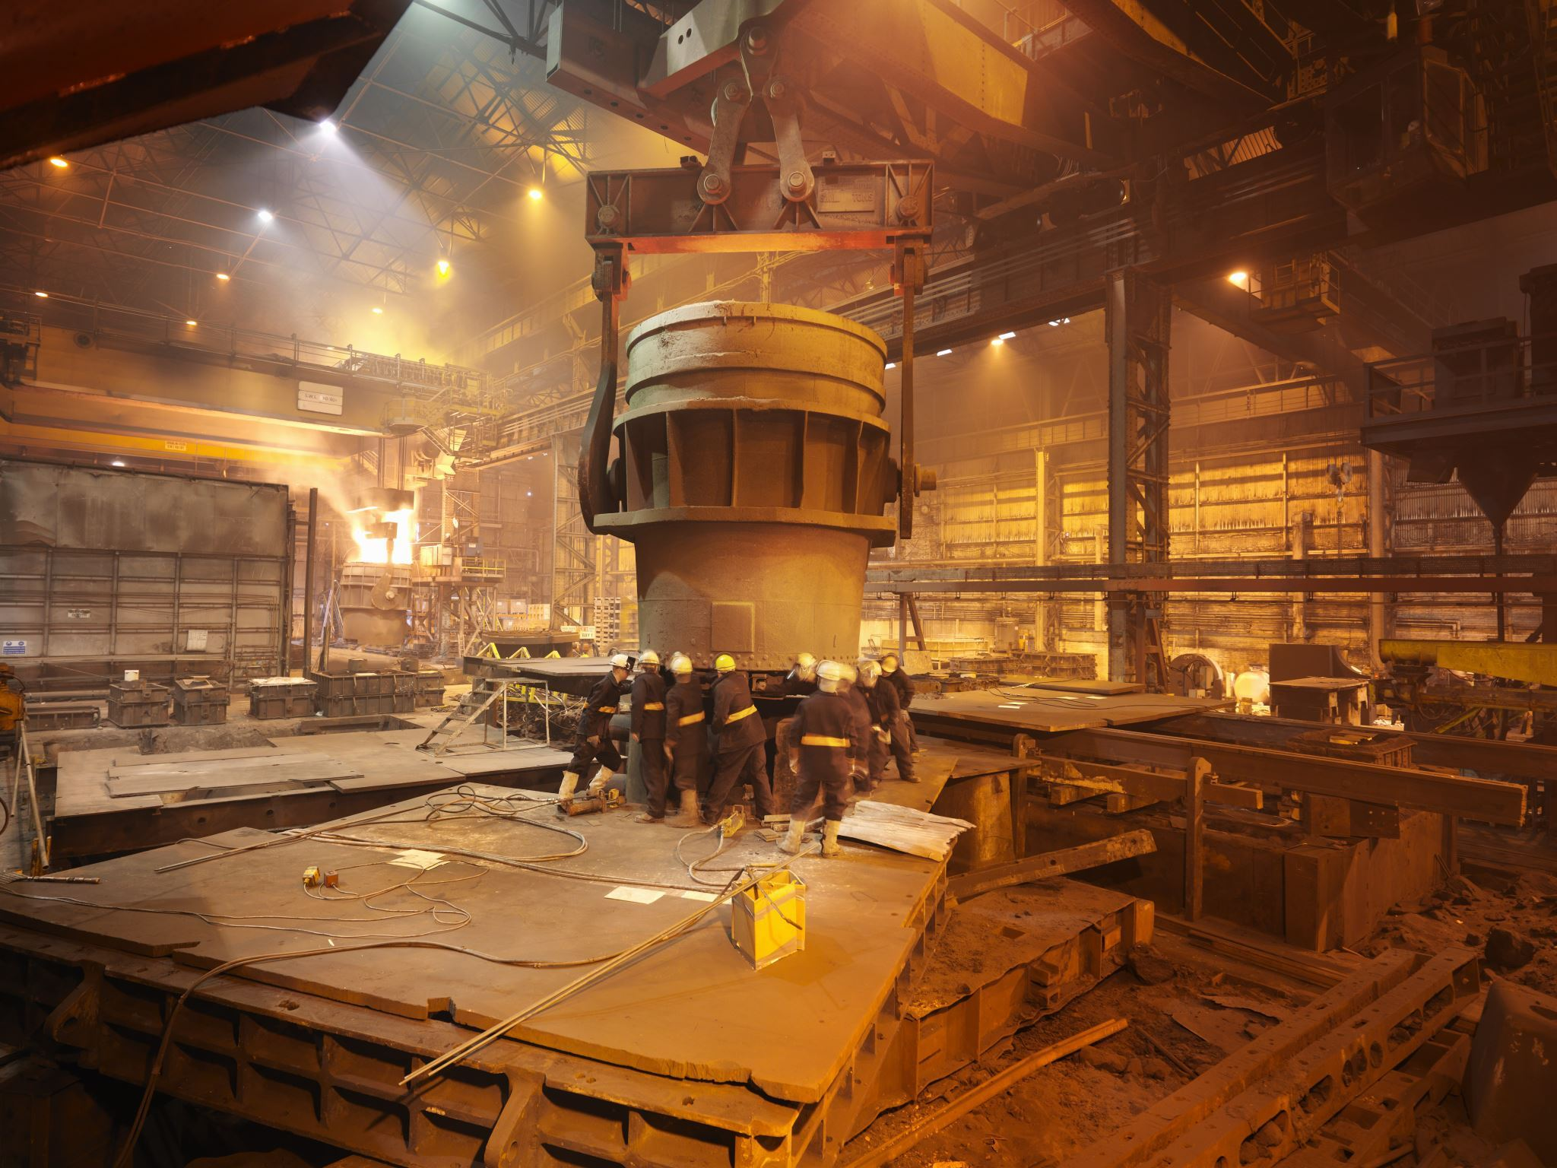
Applications of DC Motors
Elevators
Steel mills
Rolling mills
Locomotives
Excavators
Appliances, tools, toys, and automobile mechanisms

Slide 5
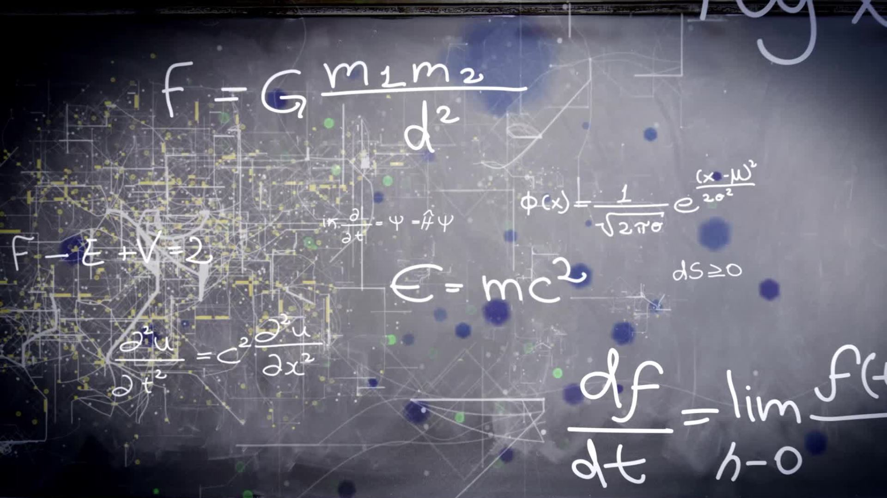
Basic steps of inheritance and class and objects
Base class is dealing with input power i.e. current and voltage as its attributes
Sub classes contains DC Motor
And another derived class will be named as DC Generator
Here the Multilevel inheritance concept will be used as taking the attributes of base class named input power to the sub class named DC Motor
And the output attributes of DC Motor will used as input attributes for DC Generator
And after this we can calculate mechanical output such as torque and efficiency

Slide 6
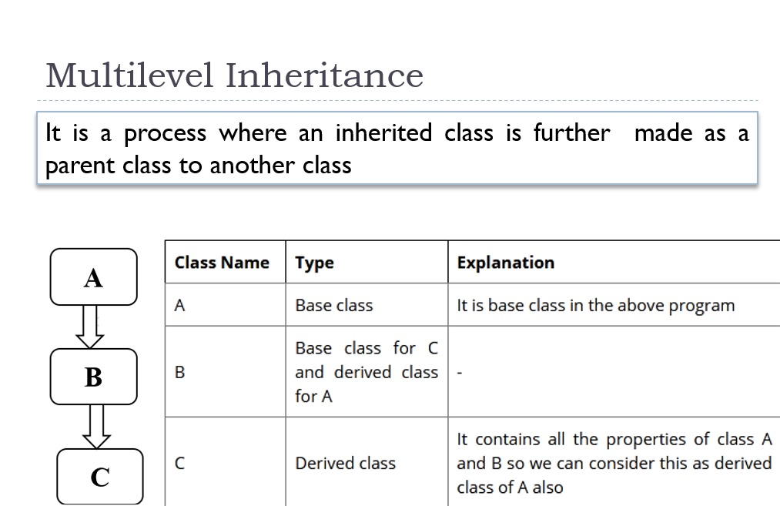

Slide 7
INPUT IDEOLOGY
INPUT :
We will take inputs as voltage and current for DC Motor
And we will get output mechanical work from DC Motor and that will be input mechanical energy for DC Generator.

Slide 8
OUTPUT IDEOLOGY
Output :
We can calculate the output of generator such as torque and efficiency
If efficiency is high then the Generator works in good condition
If efficiency is low the motor can't be used for applications

Slide 9

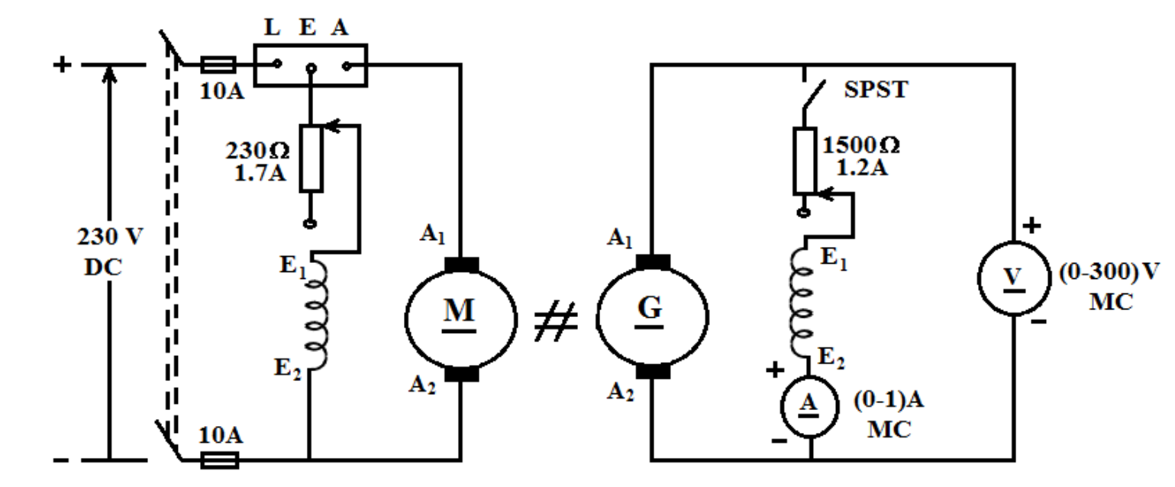
DIAGRAM

Slide 10
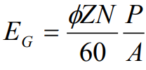
EMF Generated in Generator
In a DC generator, the expression for the voltage generated in the armature winding on no load can be written as
where
Ф flux per pole in webers which depends on field current
Z number of armature conductors-constant for a given machine
P number of poles
A number of parallel paths N speed in rpm

Slide 11


Efficiency
Power Input, Pi = VI Watts
Power Output
Efficiency, %
Induced EMF E = Vt + Ia.Ra

Slide 12
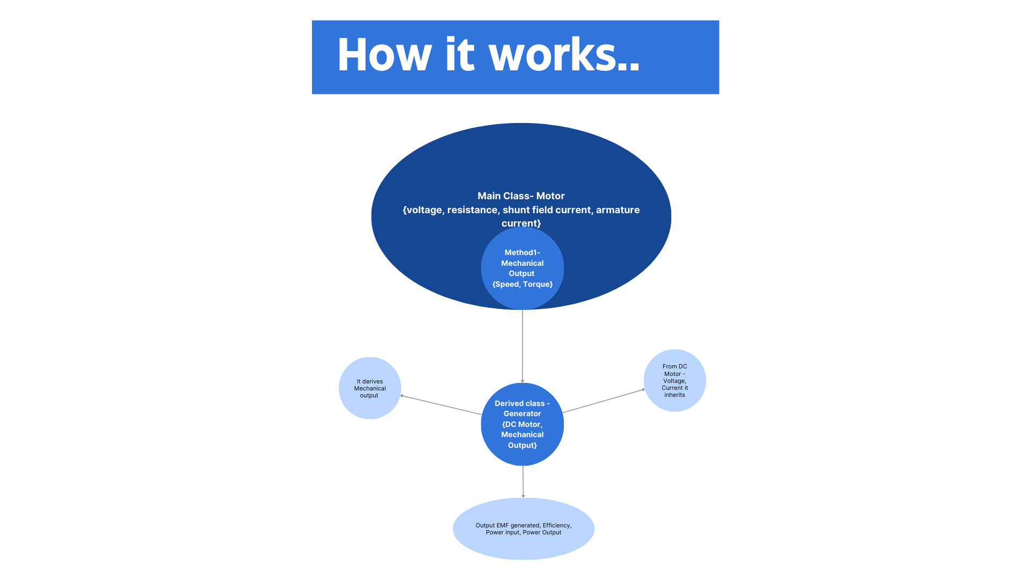

Slide 13
THANK YOU

